Slide 1
Solid State Physics Tutorial III (Carrier concentrations, Fermi energy, Fermi Velocity, Drift Current, Mobility, Diffusion Current, mean free path etc.)

Slide 2
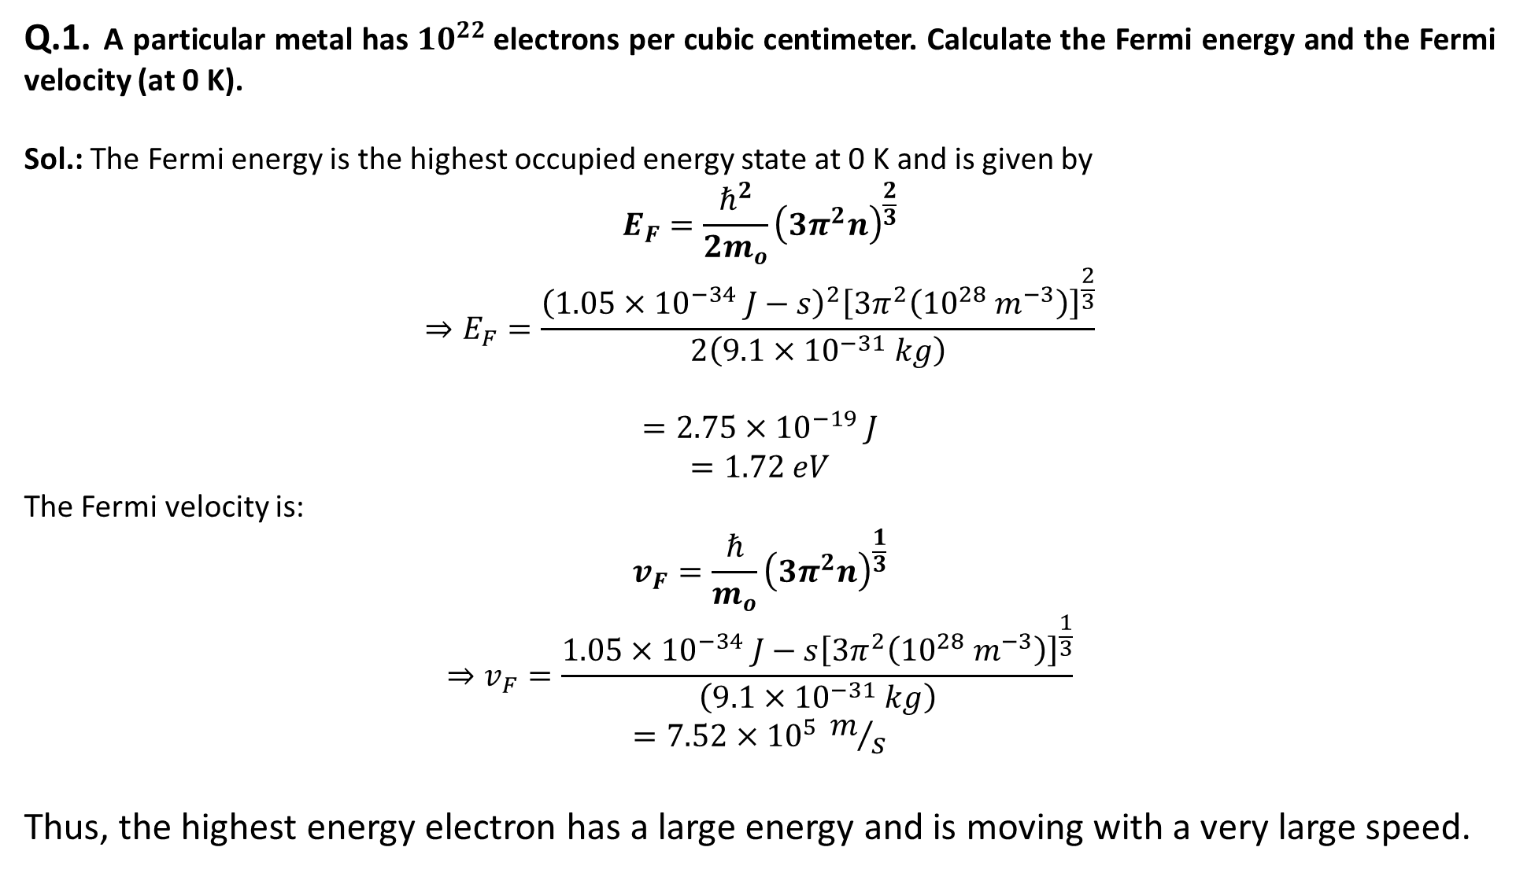
Q.1. A particular metal has $10^{22}$electrons per cubic centimeter. Calculate the Fermi energy and the Fermi velocity (at 0 K).
Sol.: The Fermi energy is the highest occupied energy state at 0 K and is given by
$$E_{F}=\frac{ℏ^{2}}{2m_{o}}{\left(3π^{2}n\right)}^{\frac{2}{3}}$$
$$⇒E_{F}=\frac{{\left(1.05×{10}^{−34} J−s\right)}^{2}{\left[3π^{2}\left({10}^{28} m^{−3}\right)\right]}^{\frac{2}{3}}}{2\left(9.1×{10}^{−31} kg\right)}$$
$$=2.75×{10}^{−19} J$$
$$=1.72 eV$$
The Fermi velocity is:
$$v_{F}=\frac{ℏ}{m_{o}}{\left(3π^{2}n\right)}^{\frac{1}{3}}$$
$$⇒v_{F}=\frac{1.05×{10}^{−34} J−s{\left[3π^{2}\left({10}^{28} m^{−3}\right)\right]}^{\frac{1}{3}}}{\left(9.1×{10}^{−31} kg\right)}$$
$$=7.52×{10}^{5} m/s$$
Thus, the highest energy electron has a large energy and is moving with a very large speed.

Slide 3
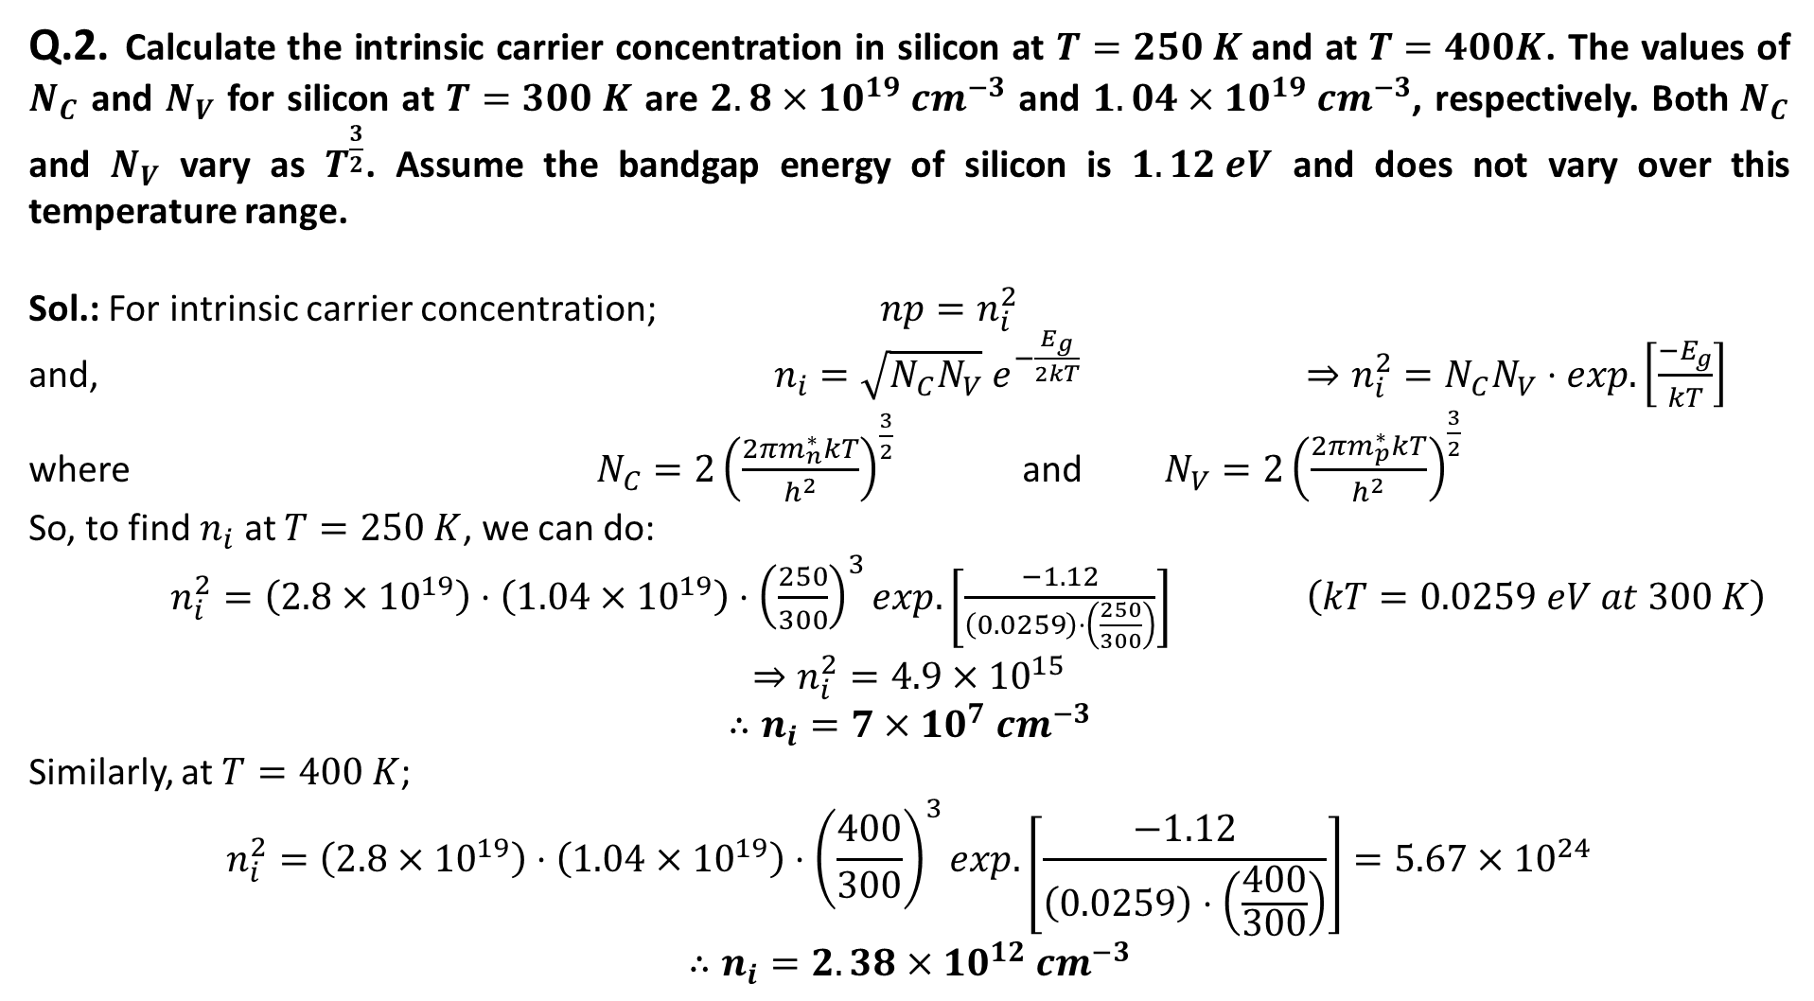
Q.2. Calculate the intrinsic carrier concentration in silicon at $T=250 K$and at $T=400K$. The values of $N_{C}$ and $N_{V}$ for silicon at $T=300 K$ are $2.8×10^{19} cm^{−3}$ and $1.04×10^{19} cm^{−3}$, respectively. Both $N_{C}$ and $N_{V}$ vary as $T^{\frac{3}{2}}$. Assume the bandgap energy of silicon is $1.12 eV$ and does not vary over this temperature range.
Sol.: For intrinsic carrier concentration; $np=n_{i}^{2}$
and, $n_{i}=\sqrt{N_{C}N_{V}} e^{−\frac{E_{g}}{2kT}}$ $⇒n_{i}^{2}=N_{C}N_{V}⋅exp.\left[\frac{−E_{g}}{kT}\right]$
where $N_{C}=2{\left(\frac{2πm_{n}^{∗}kT}{h^{2}}\right)}^{\frac{3}{2}}$ and $N_{V}=2{\left(\frac{2πm_{p}^{∗}kT}{h^{2}}\right)}^{\frac{3}{2}}$
So, to find $n_{i}$ at $T=250 K$, we can do:
$n_{i}^{2}=\left(2.8×10^{19}\right)⋅\left(1.04×{10}^{19}\right)⋅{\left(\frac{250}{300}\right)}^{3}exp.\left[\frac{−1.12}{\left(0.0259\right)⋅\left(\frac{250}{300}\right)}\right]$ $\left(kT=0.0259 eV at 300 K\right)$
$$⇒n_{i}^{2}=4.9×{10}^{15}$$
$$∴n_{i}=7×{10}^{7} cm^{−3}$$
Similarly, at $T=400 K$;
$$n_{i}^{2}=\left(2.8×10^{19}\right)⋅\left(1.04×{10}^{19}\right)⋅{\left(\frac{400}{300}\right)}^{3}exp.\left[\frac{−1.12}{\left(0.0259\right)⋅\left(\frac{400}{300}\right)}\right]=5.67×{10}^{24}$$
$$∴n_{i}=2.38×{10}^{12} cm^{−3}$$

Slide 4
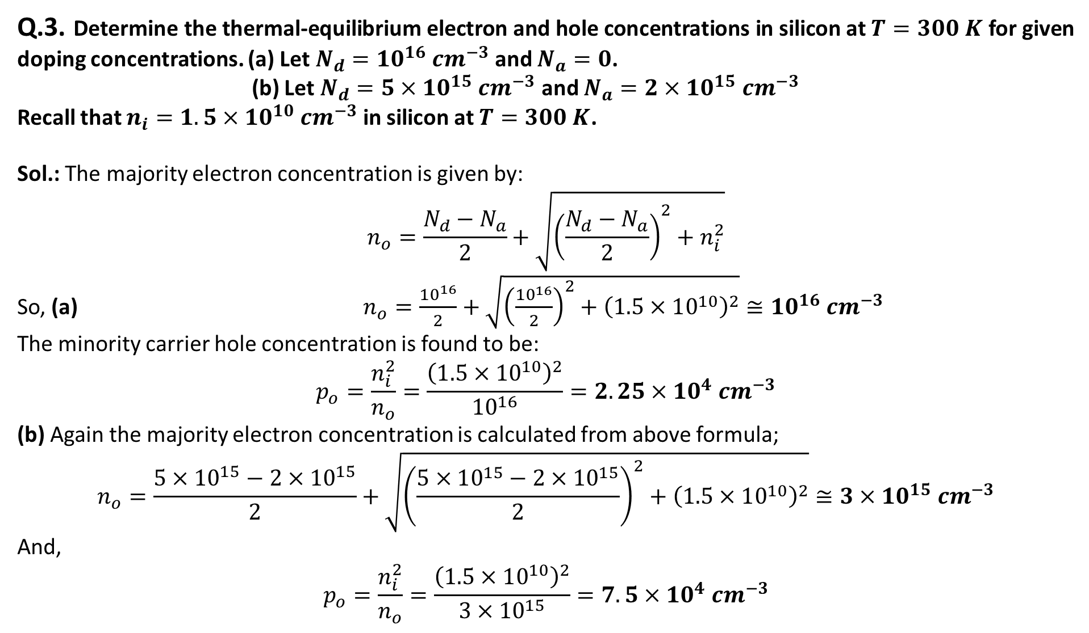
Q.3. Determine the thermal-equilibrium electron and hole concentrations in silicon at $T=300 K$ for given doping concentrations. (a) Let $N_{d}=10^{16} cm^{−3}$ and $N_{a}=0$.
(b) Let $N_{d}=5×10^{15} cm^{−3}$ and $N_{a}=2×10^{15} cm^{−3}$
Recall that $n_{i}=1.5×10^{10} cm^{−3}$ in silicon at $T=300 K$.
Sol.: The majority electron concentration is given by:
$$n_{o}=\frac{N_{d}−N_{a}}{2}+\sqrt{{\left(\frac{N_{d}−N_{a}}{2}\right)}^{2}+n_{i}^{2}}$$
So, (a) $n_{o}=\frac{{10}^{16}}{2}+\sqrt{{\left(\frac{{10}^{16}}{2}\right)}^{2}+{\left(1.5×10^{10}\right)}^{2}}≅{10}^{16} cm^{−3}$
The minority carrier hole concentration is found to be:
$$p_{o}=\frac{n_{i}^{2}}{n_{o}}=\frac{{\left(1.5×10^{10}\right)}^{2}}{{10}^{16}}=2.25×{10}^{4} cm^{−3}$$
(b) Again the majority electron concentration is calculated from above formula;
$$n_{o}=\frac{5×10^{15}−2×10^{15}}{2}+\sqrt{{\left(\frac{5×10^{15}−2×10^{15}}{2}\right)}^{2}+{\left(1.5×10^{10}\right)}^{2}}≅3×{10}^{15} cm^{−3}$$
And,
$$p_{o}=\frac{n_{i}^{2}}{n_{o}}=\frac{{\left(1.5×10^{10}\right)}^{2}}{3×{10}^{15}}=7.5×{10}^{4} cm^{−3}$$

Slide 5
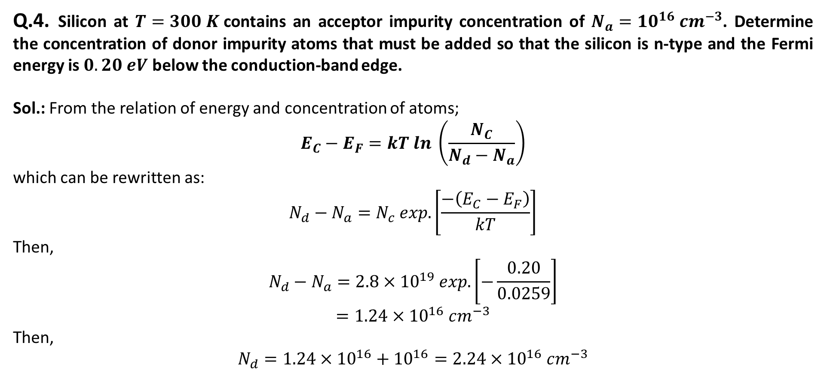
Q.4. Silicon at $T=300 K$contains an acceptor impurity concentration of $N_{a}=10^{16} cm^{−3}$. Determine the concentration of donor impurity atoms that must be added so that the silicon is n-type and the Fermi energy is $0.20 eV$ below the conduction-band edge.
Sol.: From the relation of energy and concentration of atoms;
$$E_{C}−E_{F}=kT ln \left(\frac{N_{C}}{N_{d}−N_{a}}\right)$$
which can be rewritten as:
$$N_{d}−N_{a}=N_{c} exp.\left[\frac{−\left(E_{C}−E_{F}\right)}{kT}\right]$$
Then,
$$N_{d}−N_{a}=2.8×{10}^{19} exp.\left[−\frac{0.20}{0.0259}\right]$$
$$=1.24×{10}^{16} cm^{−3}$$
Then,
$$N_{d}=1.24×{10}^{16}+{10}^{16}=2.24×{10}^{16} cm^{−3}$$

Slide 6
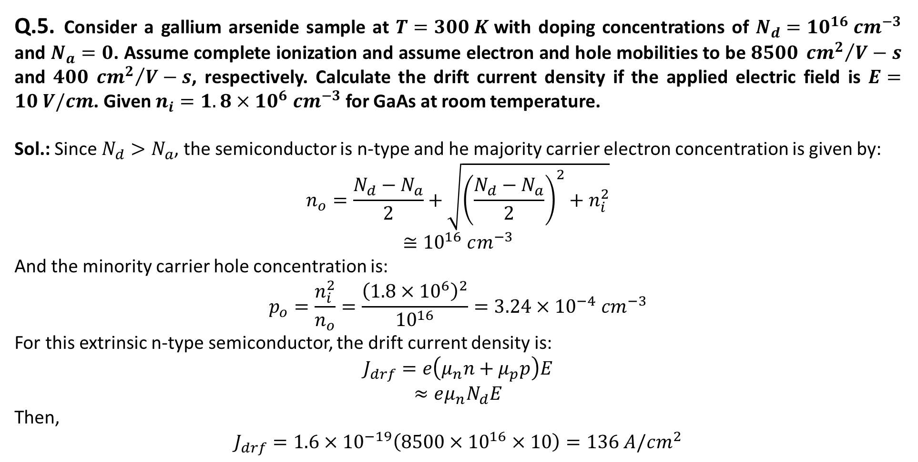
Q.5. Consider a gallium arsenide sample at $T=300 K$with doping concentrations of $N_{d}=10^{16} cm^{−3}$ and $N_{a}=0$. Assume complete ionization and assume electron and hole mobilities to be $8500 {cm^{2}}/{V−s}$ and $400 {cm^{2}}/{V−s}$, respectively. Calculate the drift current density if the applied electric field is $E=10 V/cm$. Given $n_{i}=1.8×10^{6} cm^{−3}$ for GaAs at room temperature.
Sol.: Since $N_{d}>N_{a}$, the semiconductor is n-type and he majority carrier electron concentration is given by:
$$n_{o}=\frac{N_{d}−N_{a}}{2}+\sqrt{{\left(\frac{N_{d}−N_{a}}{2}\right)}^{2}+n_{i}^{2}}$$
$$≅{10}^{16} cm^{−3}$$
And the minority carrier hole concentration is:
$$p_{o}=\frac{n_{i}^{2}}{n_{o}}=\frac{{\left(1.8×{10}^{6}\right)}^{2}}{{10}^{16}}=3.24×{10}^{−4} cm^{−3}$$
For this extrinsic n-type semiconductor, the drift current density is:
$$J_{drf}=e\left(μ_{n}n+μ_{p}p\right)E$$
$$≈eμ_{n}N_{d}E$$
Then,
$$J_{drf}=1.6×{10}^{−19}\left(8500×{10}^{16}×10\right)=136 A/cm^{2}$$

Slide 7
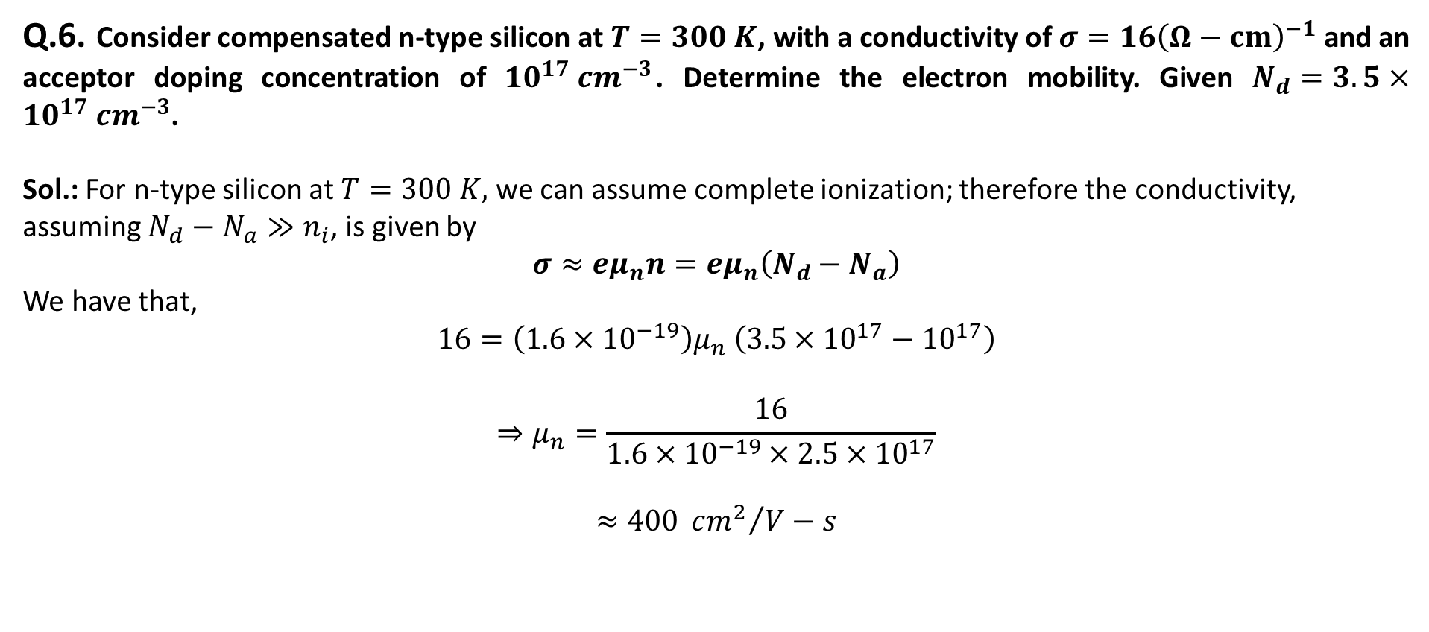
Q.6. Consider compensated n-type silicon at $T=300 K$, with a conductivity of $σ=16{\left(Ω−cm\right)}^{−1}$ and an acceptor doping concentration of $10^{17} cm^{−3}$. Determine the electron mobility. Given $N_{d}=3.5×10^{17} cm^{−3}$.
Sol.: For n-type silicon at $T=300 K,$ we can assume complete ionization; therefore the conductivity, assuming $N_{d}−N_{a}≫n_{i}$, is given by
$$σ≈eμ_{n}n=eμ_{n}\left(N_{d}−N_{a}\right)$$
We have that,
$$16=\left(1.6×{10}^{−19}\right)μ_{n} \left(3.5×{10}^{17}−{10}^{17}\right)$$
$$⇒μ_{n}=\frac{16}{1.6×{10}^{−19}×2.5×{10}^{17}}$$
$$≈400 {cm^{2}}/{V−s}$$

Slide 8
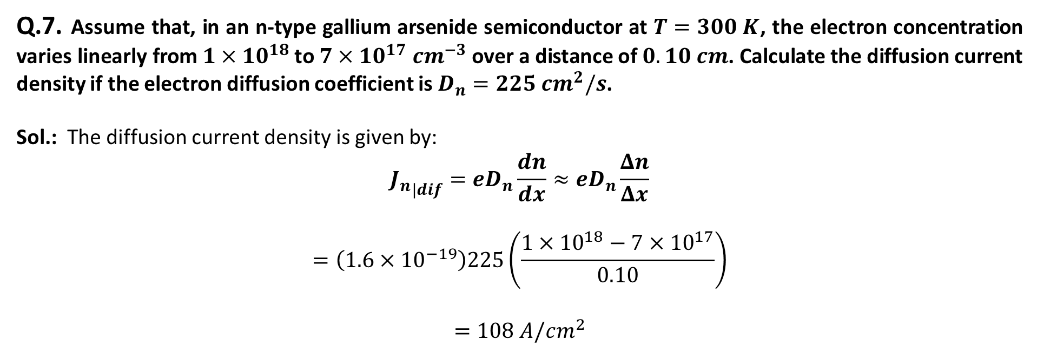
Q.7. Assume that, in an n-type gallium arsenide semiconductor at $T=300 K$, the electron concentration varies linearly from $1×10^{18}$ to $7×10^{17} cm^{−3}$ over a distance of $0.10 cm$. Calculate the diffusion current density if the electron diffusion coefficient is $D_{n}=225 cm^{2}/s$.
Sol.: The diffusion current density is given by:
$${J_{n}}_{|dif}=eD_{n}\frac{dn}{dx}≈eD_{n}\frac{Δn}{Δx}$$
$$=\left(1.6×{10}^{−19}\right)225\left(\frac{1×10^{18}−7×10^{17}}{0.10}\right)$$
$$=108 A/cm^{2}$$

Slide 9
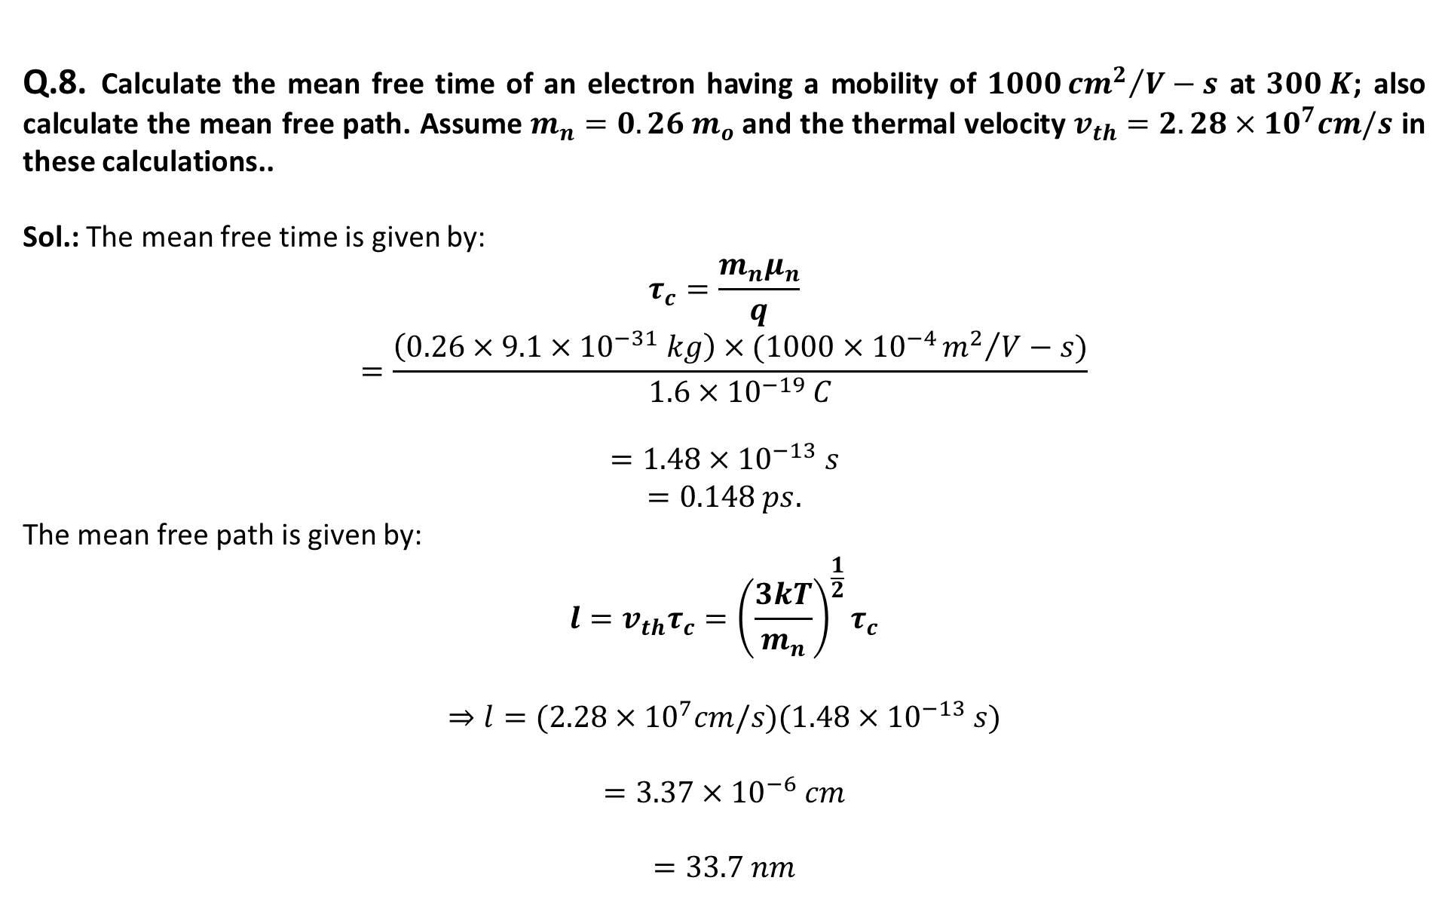
Q.8. Calculate the mean free time of an electron having a mobility of $1000{cm^{2}}/{V−s}$ at $300 K$; also calculate the mean free path. Assume $m_{n}=0.26 m_{o}$and the thermal velocity $v_{th}=2.28×10^{7}cm/s$ in these calculations..
Sol.: The mean free time is given by:
$$τ_{c}=\frac{m_{n}μ_{n}}{q}$$
$$=\frac{\left(0.26×9.1×{10}^{−31} kg\right)×(1000×{10}^{−4}{m^{2}}/{V−s})}{1.6×{10}^{−19} C}$$
$$=1.48×{10}^{−13} s$$
$$=0.148 ps.$$
The mean free path is given by:
$$l=v_{th}τ_{c}={\left(\frac{3kT}{m_{n}}\right)}^{\frac{1}{2}}τ_{c}$$
$$⇒l=(2.28×{10}^{7}cm/s)(1.48×{10}^{−13} s)$$
$$=3.37×{10}^{−6} cm$$
$$=33.7 nm$$

Slide 10
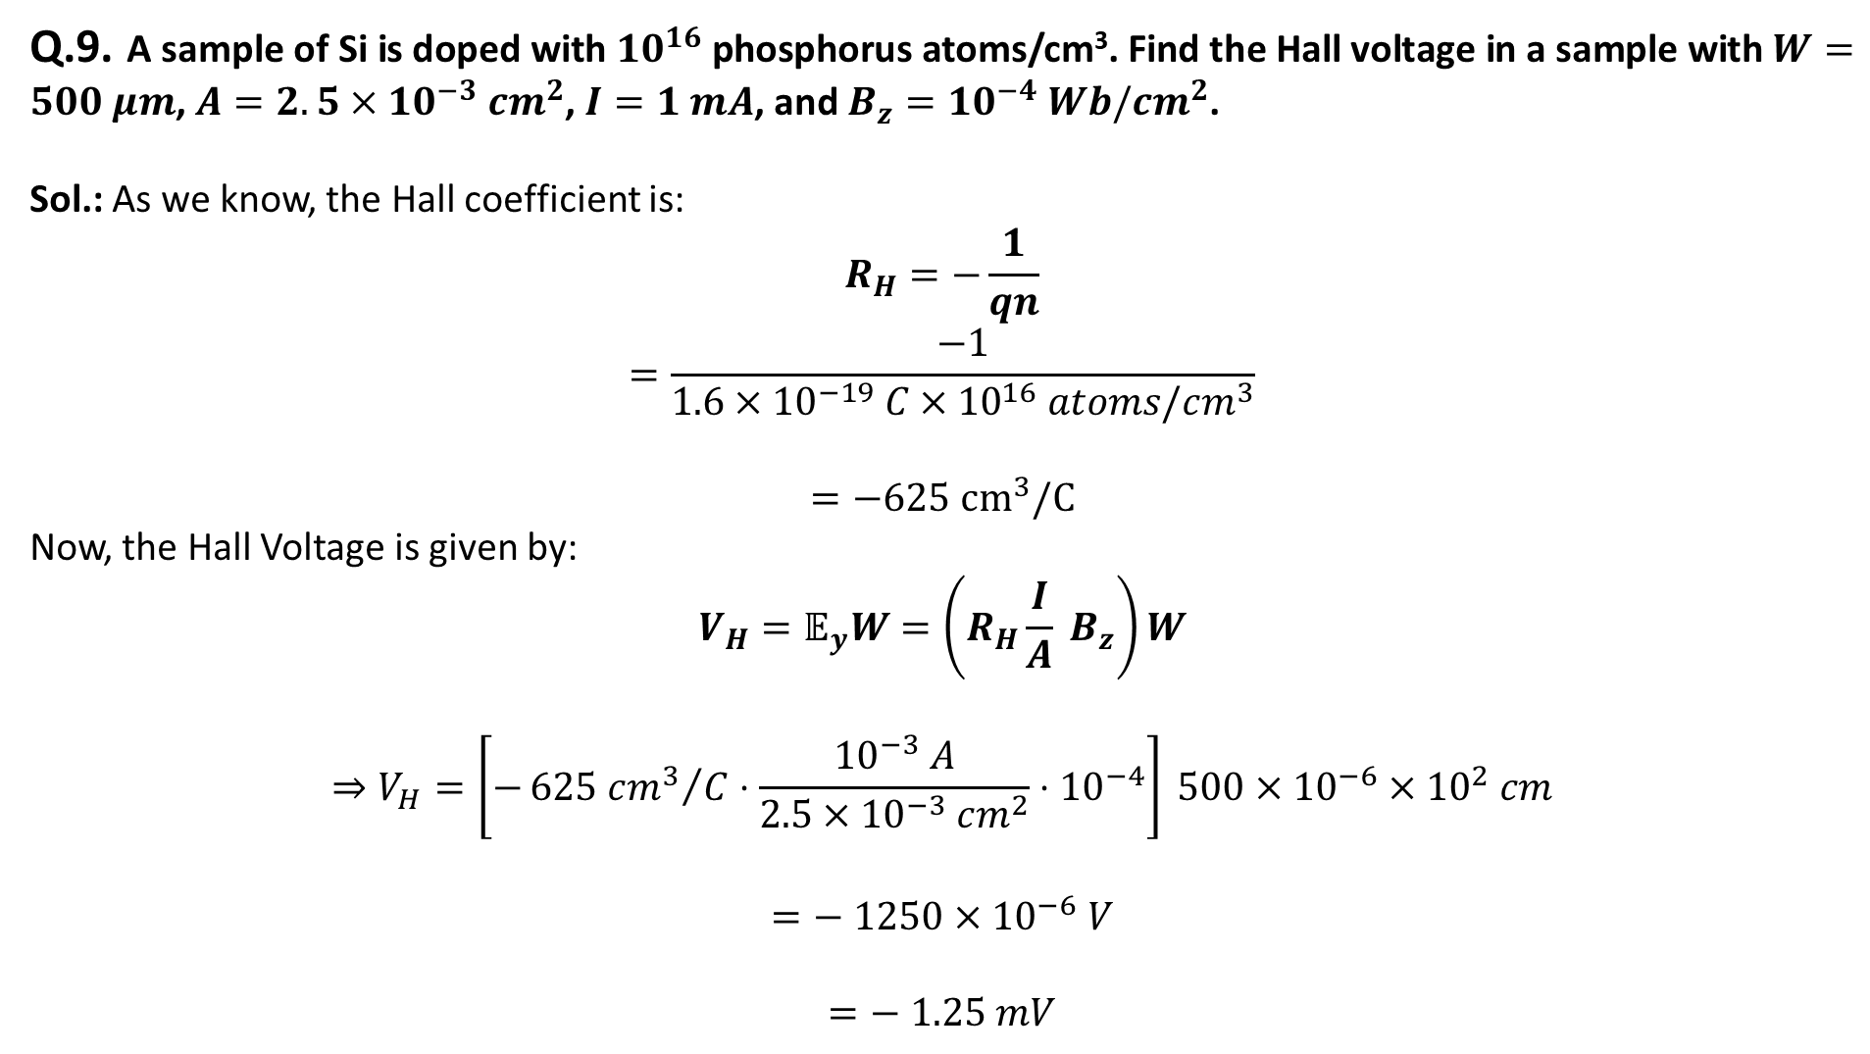
Q.9. A sample of Si is doped with $10^{16}$ phosphorus atoms/cm³. Find the Hall voltage in a sample with $W=500 μm$, $A=2.5×10^{−3} cm^{2}$, $I=1 mA$, and $B_{z}=10^{−4} Wb/cm^{2}$.
Sol.: As we know, the Hall coefficient is:
$$R_{H}=−\frac{1}{qn}$$
$$=\frac{−1}{1.6×{10}^{−19} C×{10}^{16} atoms/cm^{3}}$$
$$=−625 {cm}^{3}/C$$
Now, the Hall Voltage is given by:
$$V_{H}=𝔼_{y}W=\left(R_{H}\frac{I}{A} B_{z}\right)W$$
$$⇒V_{H}=\left[−{625 cm^{3}}/C⋅\frac{{10}^{−3} A}{2.5×{10}^{−3} cm^{2}}⋅{10}^{−4}\right] 500×{10}^{−6}×{10}^{2} cm$$
$$=− 1250×{10}^{−6} V$$
$$=− 1.25 mV$$

Slide 11
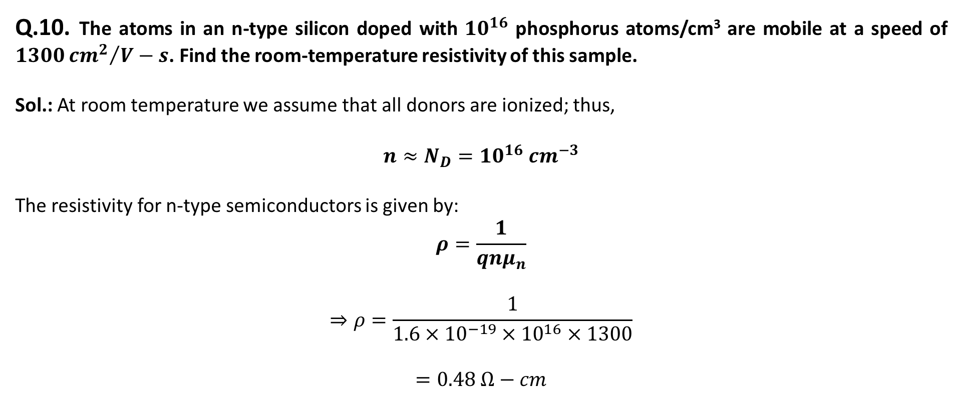
Q.10. The atoms in an n-type silicon doped with $10^{16}$ phosphorus atoms/cm³ are mobile at a speed of $1300{cm^{2}}/{V−s}$. Find the room-temperature resistivity of this sample.
Sol.: At room temperature we assume that all donors are ionized; thus,
$$n≈N_{D}=10^{16} cm^{−3}$$
The resistivity for n-type semiconductors is given by:
$$ρ=\frac{1}{qnμ_{n}}$$
$$⇒ρ=\frac{1}{1.6×{10}^{−19}×{10}^{16}×1300}$$
$$=0.48 Ω−cm$$

